Slide 1
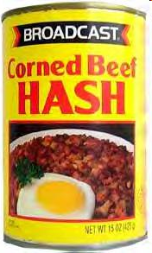
Hash Tables
“hash collision n. [from the techspeak] (var. ‘hash clash’)
When used of people, signifies a confusion in associative memory or imagination, especially a persistent one.”
-The Hacker's Dictionary
CLRS, Sections 11.1 – 11.5

Slide 2
Basic Data Structures
Array-based Lists
O(1) - access
O(n) - insertion, better at end
O(n) - deletion
Double Linked-List Implementations
O(n) - access
O(n) - insertion, better at front / back
O(n) - deletion, better at front / back
Binary Search Trees (to be seen in two weeks)
O(log n) - access, if balanced
O(log n) - insertion, if balanced
O(log n) - deletion, if balanced

Slide 3
Why are Binary Trees Better?
Divide and Conquer
Reduce work by a factor of 2 each time.
Can we reduce the work by a bigger factor?
10?
1000?
An array-based List does this in a way when accessing elements.
But index must use an integer value.
Each position holds a single element.

Slide 4
Hash Table ADT
How to efficiently manages a dynamic set that supports these dictionary operations:
INSERT
SEARCH
DELETE
Each element in the set has a key.
The universe of the keys is U={0,1,…,m-1}.
How represent the dynamic set:
If m =|U| is small, then use an array (direct-address table).
If m =|U| is large, then use a hash table.

Slide 5
Direct-Access Tables
The universe of the keys is U={0,1,…,m-1}, and m is small.
We use an array T[0..m-1], where we allocate a slot for each possible key in U.
It is called Direct-Access Table because we use the key of the element directly as an address (index in the array).
The element with key k is stored in T[k],
0 ≤ k ≤(m-1).

Slide 6
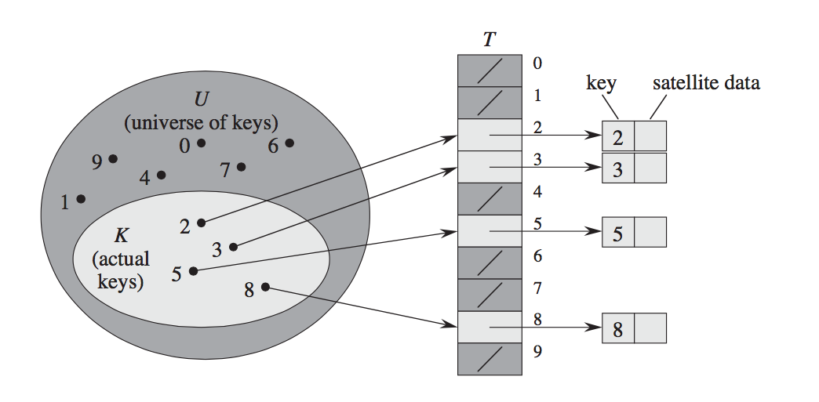
Example: Direct-Access Tables
U = {0, 1, …, 9}
The dynamic set contains elements with keys K = {2, 3, 5, 8}

Slide 7
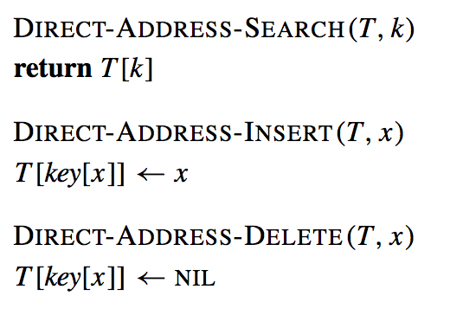
Direct-Access Tables Operations
If there is an element x with key k, then T[k] contains a pointer to x.
Otherwise, T[k] is empty (NIL).
Dictionary operations are trivial and take O(1) time.

Slide 8
Hash Tables
When the universe U ={0, 1, …, m’-1} is large, storing a table (or array) T of size |U|=m’ may be impractical because of space reasons.
Often, the set K of keys actually stored is also small (|K| << |U|). Most of the space allocated for an array T of size m’=|U| is wasted.
SOLUTION? Hash Tables!

Slide 9
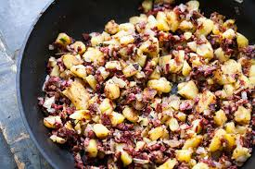

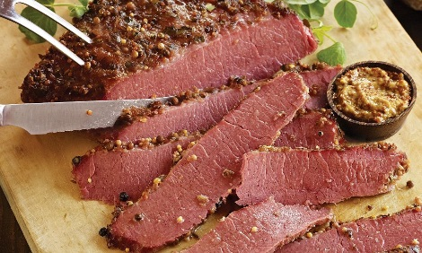
Hash Tables
Hash Tables overcome the problems of Direct Access Tables.
Maintain fast access, insertion and deletion.
But also reduce possibility of wasted space.
Hash tables use an array and hash functions to determine the index for each element.

Slide 10
Hash Tables
IDEA: Use array T[0..m-1]of size m << m’
and a hash function h
h: U → {0, 1, …, m-1}
mapping the key k to an index of the array T
The element with key k now is stored in slot h(k).
We say that k hashes to slot h(k).

Slide 11
Hash Functions
Hash: "From the French hatcher, which means 'to chop'. "
to hash: to mix randomly or shuffle
Hash Function: Take a large piece of data and reduce it to a smaller piece of data, usually a single integer.
A function or algorithm.
The input need not be integers!

Slide 12

Hash Function
12/30/1984
300389085
3302466556
2
“LeBron James”
hash function
@KingJames
“The L-Train”

Slide 13
Simple Example
Assume we are using names as our key.
Take 3rd letter of name, ignoring case.
Take integer value of letter (a = 0, b = 1, ...).
Divide by 6 and take remainder.
What does “LeBron" hash to?
B # 2
2 % 6 = 2

Slide 14
Result of Hash Function
Examples:
Mike = 10 % 6 = 4
Kelly = 11 % 6 = 5
Olivia = 8 % 6 = 2
Isabelle = 0 % 6 = 0
David = 21 % 6 = 3
Margaret = 17 % 6 = 5 (uh-oh)

Slide 15
Imperfect Hash Functions
This is an imperfect hash function.
More than one name hashes to same value.
This is called a collision.
A perfect hash function yields a one-to-one mapping from the keys to the hash values.
What is the maximum number of values this function can hash perfectly?

Slide 16
Division Method
A good hash function: simple uniform hashing
Any element is equally likely to hash into any of the m slots, independently of where any other element has hashed to.
The division method: take the remainder of k divided by m
h(k) = k mod m
Example: k = 100, m = 12, h(k)= 4.
O(1) to compute.

Slide 17
Division Method
m should NOT be a power of 2.
If m = 2^{p}, then h(k) is the p low-order bits of k.
Makes is easier to guess hash function.
It is better to make hash function depends on all bits of the key.
Good choice for m:
Primes that are not too close to exact powers of 2.

Slide 18
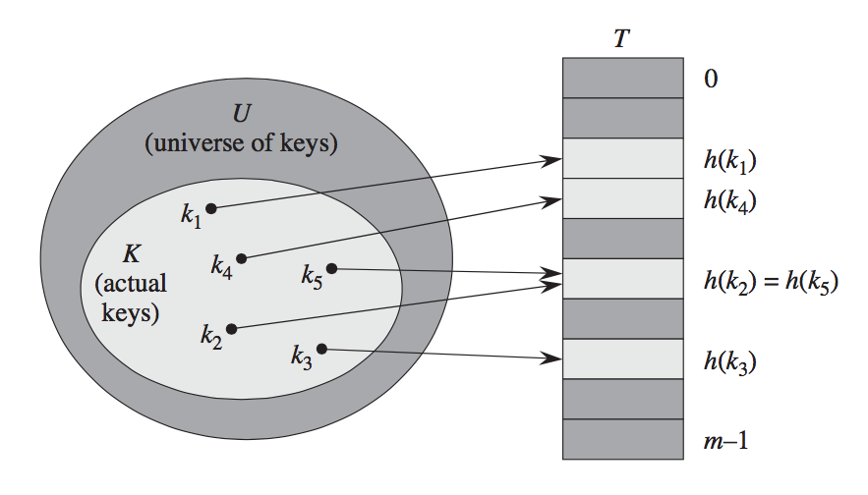
Example: Hash Tables
COLLISION problem:
Two different keys k₂ and k₅ hash in the same slot.
h(k₂) = h(k₅)

Slide 19

Handling Collisions
What to do when inserting an element and already something present?

Slide 20
Collisions
Collisions: When two or more keys hash to the same slot.
For a given set K of keys, collisions may or may not happen if |K| ≤ m.
Collisions likely when |K| > m.
How to handle collisions?
Chaining (Closed Addressing)
Open Addressing

Slide 21

Closed Addressing: Chaining
Each element of hash table links to another data structure.
For instance, can use a linked list or balanced binary tree.
Takes more space, but easier to use and implement than other methods.
Everything goes in its spot.

Slide 22
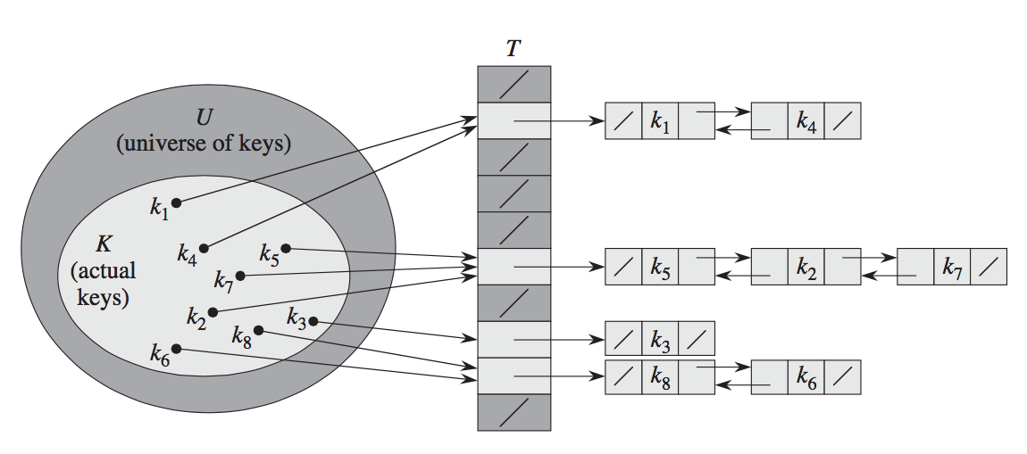
Chaining
Put all elements that hash to the same slot into a linked list
Slot j contains a pointer to head of the list of all stored elements that hash to j.
If there are no elements, slot j contains NIL.

Slide 23
Example: Chaining
Using m = 7, and this hash function:
h(k) = k mod 7
1. insert(76):
h(76) = (76) mod 7 = 6
0 | NIL
1 | NIL
2 | NIL
3 | NIL
4 | NIL
5 | NIL
6
76 | /

Slide 24
Example: Chaining
2. insert(93):
h(93) = (93) mod 7 = 2
0 | NIL
1 | NIL
2
3 | NIL
4 | NIL
5 | NIL
6
93 | /
76 | /

Slide 25
Example: Chaining
3. insert(40):
h(40) = (40) mod 7 = 5
0 | NIL
1 | NIL
2
3 | NIL
4 | NIL
5
6
93 | /
40 | /
76 | /

Slide 26
Example: Chaining
4. insert(47):
h(47) = (47) mod 7 = 5
0 | NIL
1 | NIL
2
3 | NIL
4 | NIL
5
6
93 | /
47
40 | /
76 | /

Slide 27
Example: Chaining
5. insert(10):
h(10) = (10) mod 7 = 3
0 | NIL
1 | NIL
2
3
4 | NIL
5
6
93 | /
10 | /
47
40 | /
76 | /

Slide 28
Example: Chaining
6. insert(55):
h(55) = (55) mod 7 = 6
0 | NIL
1 | NIL
2
3
4 | NIL
5
6
93 | /
10 | /
40
47 | /
55
76 | /

Slide 29

Chaining : Insertion
Implementing INSERTION with chaining:
Worst-case running time is O(1).
Assuming element being inserted is not already in the list.
Otherwise, additional cost for insertion.

Slide 30

Chaining: Search
Implementing SEARCH with chaining:
Running time proportional to the length of the list of elements in slot h(k).
Depends on efficiency of the hash function.
Why?

Slide 31
Load Factor
Given a hash table T with m slots that stores n elements, the load factor α for T is n/m, i.e. the average number of elements stored in a chain.
Assumption on hashing function h:
simple uniform hashing: any element is equally likely to hash into any of the m slots.
In the case of chaining, the expected value of the length of the list in slot h(k) is α.

Slide 32
Chaining: Search
Average running time: proportional to the length of the list of elements in slot h(k) which is α, then running time is θ(α).
If n = O(m), then α = O(m)/m = O(1) and searching takes constant time.
Worst case: All n keys hash to the same slot creating a list of length n. Then, time for searching is θ(n).

Slide 33

Chaining: Deletion
Implementing DELETION with chaining:
x is a pointer to the element to remove.
Runtime same as searching.
Average running time: θ(α).
If n = O(m), then takes constant time.
Worst case: θ(n).

Slide 34
Runtime for Operations with Chaining
Worst case: θ(n)for searching and deleting.
Average case: Under reasonable assumptions (e.g. simple uniform hashing and n = O(m)), the average time in O(1).

Slide 35
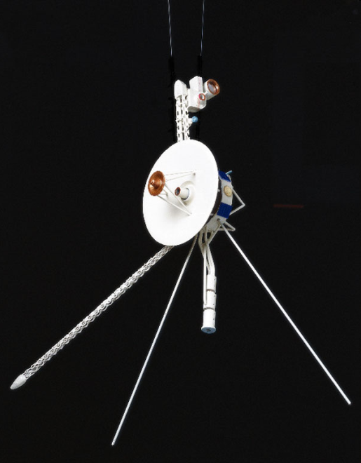
Open Addressing
Each entry in the table T contains at most one element, i.e. α ≤ 1.
IDEA: We successively examine, or probe, the hash table cells until we find an empty slot in which to put the key.
The sequence of positions probed depends upon the key being inserted.
Three types of probing:
Linear
Quadratic
Double hashing

Slide 36
Linear Probing
Given an ordinary hash function
h’: U → {0, 1, …, m-1}
referred to as the auxiliary hash function,
the method of linear probing uses the hash
function
h(k, i) = (h’(k)+ i) mod m
for i = 0, 1, …, m-1
i starts at 0. If no collision, insert at that location.
If collision, increase i until find open slot.

Slide 37
Linear Probing
h(k, i) = (h’(k) + i) mod m
for i = 0, 1, …, m-1
Probing sequence:
T[h’(k)] the first probed slot is given by h’
T[h’(k)+1]
…
T[m-1]
T[0]
…
T[h’(k)-1]

Slide 38
Example: Linear Probing
Using m = 7,
h(k,i) = (h’(k)+ i) mod 7
1. insert(76):
h(76,0) = (h’(76)+ 0) mod 7
= (6) mod 7 = 6
probes = 1
0 | 1 | 2 | 3 | 4 | 5 | 6
 |  |  |  |  |  | 76

Slide 39
Example: Linear Probing
2. insert(93):
h(93,0) = (h’(93)+ 0) mod 7
= (2) mod 7 = 2
probes = 1
0 | 1 | 2 | 3 | 4 | 5 | 6
 |  | 93 |  |  |  | 76

Slide 40
Example: Linear Probing
3. insert(40):
h(40,0) = (h’(40)+ 0) mod 7
= (5) mod 7 = 5
probes = 1
0 | 1 | 2 | 3 | 4 | 5 | 6
 |  | 93 |  |  | 40 | 76

Slide 41
Example: Linear Probing
4. insert(47):
h(47,0) = (h’(47)+ 0) mod 7
= (5) mod 7 = 5 ← occupied
probes = 1
0 | 1 | 2 | 3 | 4 | 5 | 6
 |  | 93 |  |  | 40 | 76

Slide 42
Example: Linear Probing
4. insert(47):
h(47,1) = (h’(47)+ 1) mod 7
= (6) mod 7 = 6 ← occupied
probes = 2
0 | 1 | 2 | 3 | 4 | 5 | 6
 |  | 93 |  |  | 40 | 76

Slide 43
Example: Linear Probing
4. insert(47):
h(47,2) = (h’(47)+ 2) mod 7
= (7) mod 7 = 0
probes = 3
0 | 1 | 2 | 3 | 4 | 5 | 6
47 |  | 93 |  |  | 40 | 76

Slide 44
Example: Linear Probing
5. insert(10):
h(10,0) = (h’(10)+ 0) mod 7
= (3) mod 7 = 3
probes = 1
0 | 1 | 2 | 3 | 4 | 5 | 6
47 |  | 93 | 10 |  | 40 | 76

Slide 45
Example: Linear Probing
6. insert(55):
h(55,0) = (h’(55)+ 0) mod 7
= (6) mod 7 = 6 ←occupied
probes = 1
0 | 1 | 2 | 3 | 4 | 5 | 6
47 |  | 93 | 10 |  | 40 | 76

Slide 46
Example: Linear Probing
6. insert(55):
h(55,1) = (h’(55)+ 1) mod 7
= (0) mod 7 = 0 ←occupied
probes = 2
0 | 1 | 2 | 3 | 4 | 5 | 6
47 |  | 93 | 10 |  | 40 | 76

Slide 47
Example: Linear Probing
6. insert(55):
h(55,2) = (h’(55)+ 2) mod 7
= (1) mod 7 = 1 ←occupied
probes = 3
0 | 1 | 2 | 3 | 4 | 5 | 6
47 | 55 | 93 | 10 |  | 40 | 76

Slide 48
Linear Probing
Problem: primary clustering
long runs of occupied slots.
0 | 1 | 2 | 3 | 4 | 5 | 6
47 | 55 | 93 | 10 |  | 40 | 76
Each cluster is a group of consecutive and occupied locations in the hash table
During an insertion, any collision within a cluster causes the cluster to get larger.

Slide 49
Quadratic Probing
Quadratic Probing uses a hash function of the form
h(k,i) = (h’(k) + c₁*i + c₂*i²) mod m
where
h’(k) = k mod m
The first position probed is T[h’(k)], then we move with an offset quadratic in i.

Slide 50
Quadratic Probing
Choosing c₁, c₂, and m to fully utilize the table:
Examine every table position in the worst case.
Check c₁ = c₂ = ½ and m = 2^{p}.

Slide 51
Example: Quadratic Probing
Using m = 8, and c₁ = c₂ = ½
h(k,i) = (h’(k) + c₁*i + c₂*i²) mod 8
1. insert(76):
h(76,0) = (h’(76) + ½*0 + ½*0²) mod 8
= (4) mod 8 = 4
probes = 1
0 | 1 | 2 | 3 | 4 | 5 | 6 | 7
 |  |  |  | 76

Slide 52
Example: Quadratic Probing
2. insert(93):
h(93,0) = (h’(93) + ½*0 + ½*0²) mod 8
= (5) mod 8 = 5
probes = 1
0 | 1 | 2 | 3 | 4 | 5 | 6 | 7
 |  |  |  | 76 | 93

Slide 53
Example: Quadratic Probing
3. insert(40):
h(40,0) = (h’(40) + ½*0 + ½*0²) mod 8
= (0) mod 8 = 0
probes = 1
0 | 1 | 2 | 3 | 4 | 5 | 6 | 7
40 |  |  |  | 76 | 93

Slide 54
Example: Quadratic Probing
4. insert(47):
h(47,0) = (h’(47) + ½*0 + ½*0²) mod 8
= (7) mod 8 = 7
probes = 1
0 | 1 | 2 | 3 | 4 | 5 | 6 | 7
40 |  |  |  | 76 | 93 |  | 47

Slide 55
Example: Quadratic Probing
5. insert(10):
h(10,0) = (h’(10) + ½*0 + ½*0²) mod 8
= (2) mod 8 = 2
probes = 1
0 | 1 | 2 | 3 | 4 | 5 | 6 | 7
40 |  | 10 |  | 76 | 93 |  | 47

Slide 56
Example: Quadratic Probing
6. insert(55):
h(55,0) = (h’(55) + ½*0 + ½*0²) mod 8
= (7) mod 8 = 7 ← occupied
probes = 1
0 | 1 | 2 | 3 | 4 | 5 | 6 | 7
40 |  | 10 |  | 76 | 93 |  | 47

Slide 57
Example: Quadratic Probing
6. insert(55):
h(55,1) = (h’(55) + ½*1 + ½*1²) mod 8
= (7 + 1) mod 8 = 0 ← occupied
probes = 2
0 | 1 | 2 | 3 | 4 | 5 | 6 | 7
40 |  | 10 |  | 76 | 93 |  | 47

Slide 58
Example: Quadratic Probing
6. insert(55):
h(55,2) = (h’(55) + ½*2 + ½*2²) mod 8
= (7 + 3) mod 8 = 2 ← occupied
probes = 3
0 | 1 | 2 | 3 | 4 | 5 | 6 | 7
40 |  | 10 |  | 76 | 93 |  | 47

Slide 59
Example: Quadratic Probing
6. insert(55):
h(55,3) = (h’(55) + ½*3 + ½*3²) mod 8
= (7 + 6) mod 8 = 5 ← occupied
probes = 4
0 | 1 | 2 | 3 | 4 | 5 | 6 | 7
40 |  | 10 |  | 76 | 93 |  | 47

Slide 60
Example: Quadratic Probing
6. insert(55):
h(55,4) = (h’(55) + ½*4 + ½*4²) mod 8
= (7 + 10) mod 8 = 1
probes = 5
0 | 1 | 2 | 3 | 4 | 5 | 6 | 7
40 | 55 | 10 |  | 76 | 93 |  | 47

Slide 61
Quadratic Probing
If two keys have the same initial probe position, then their probe sequences are the same
If h(k₁,0) = h(k₂,0), then h(k₁,i) = h(k₂,i).
Milder form of clustering: secondary clustering.
As in linear probing, the initial probe determines the entire sequence (only m distinct probe sequences are used).

Slide 62
Double Hashing
In double hashing, the probe sequence is
h(k,i) = (h₁(k) + i*h₂(k)) mod m
where both h₁ and h₂ are auxiliary hash functions.
The initial probe goes in position T[h₁(k)], then the offset is determined by h₂(k).

Slide 63
Example: Double Hashing
Using m = 7, m-2 = 5, and these hash functions:
h(k,i) = (h₁(k) + i*h₂(k)) mod 7
where
h₁(k) = k mod 7
h₂(k) = 1 + (k mod 5)

Slide 64
Example: Double Hashing
1. insert(76):
h₁ = 76 mod 7 = 6
h₂ = 1 + (76 mod 5) = 2
h(76,0) = (h₁(76) + 0*h₂(76)) mod 7
= (6 + 0*2) mod 7
= 6
probes = 1
0 | 1 | 2 | 3 | 4 | 5 | 6
 |  |  |  |  |  | 76

Slide 65
Example: Double Hashing
2. insert(93):
h₁ = 93 mod 7 = 2
h₂ = 1 + (93 mod 5) = 4
h(93,0) = (h₁(93) + 0*h₂(93)) mod 7
= (2 + 0*4) mod 7
= 2
probes = 1
0 | 1 | 2 | 3 | 4 | 5 | 6
 |  | 93 |  |  |  | 76

Slide 66
Example: Double Hashing
3. insert(40):
h₁ = 40 mod 7 = 5
h₂ = 1 + (40 mod 5) = 1
h(40,0) = (h₁(40) + 0*h₂(40)) mod 7
= (5 + 0*1) mod 7
= 5
probes = 1
0 | 1 | 2 | 3 | 4 | 5 | 6
 |  | 93 |  |  | 40 | 76

Slide 67
Example: Double Hashing
4. insert(47):
h₁ = 47 mod 7 = 5
h₂ = 1 + (47 mod 5) = 3
h(47,0) = (h₁(47) + 0*h₂(47)) mod 7
= (5 + 0*3) mod 7
= 5 ← occupied
probes = 1
0 | 1 | 2 | 3 | 4 | 5 | 6
 |  | 93 |  |  | 40 | 76

Slide 68
Example: Double Hashing
4. insert(47):
h₁ = 47 mod 7 = 5
h₂ = 1 + (47 mod 5) = 3
h(47,1) = (h₁(47) + 1*h₂(47)) mod 7
= (5 + 1*3) mod 7
= 1
probes = 2
0 | 1 | 2 | 3 | 4 | 5 | 6
 | 47 | 93 |  |  | 40 | 76

Slide 69
Example: Double Hashing
5. insert(10):
h₁ = 10 mod 7 = 3
h₂ = 1 + (10 mod 5) = 1
h(10,0) = (h₁(10) + 0*h₂(10)) mod 7
= (3 + 0*1) mod 7
= 3
probes = 1
0 | 1 | 2 | 3 | 4 | 5 | 6
47 |  | 93 | 10 |  | 40 | 76

Slide 70
Example: Double Hashing
6. insert(55):
h₁ = 55 mod 7 = 6
h₂ = 1 + (55 mod 5) = 1
h(55,0) = (h₁(55) + 0*h₂(55)) mod 7
= (6 + 0*1) mod 7
= 6 ← occupied
probes = 1
0 | 1 | 2 | 3 | 4 | 5 | 6
47 |  | 93 | 10 |  | 40 | 76

Slide 71
Example: Double Hashing
6. insert(55):
h₁ = 55 mod 7 = 6
h₂ = 1 + (55 mod 5) = 1
h(55,1) = (h₁(55) + 1*h₂(55)) mod 7
= (6 + 1*1) mod 7
= 0 ← occupied
probes = 2
0 | 1 | 2 | 3 | 4 | 5 | 6
47 |  | 93 | 10 |  | 40 | 76

Slide 72
Example: Double Hashing
6. insert(55):
h₁ = 55 mod 7 = 6
h₂ = 1 + (55 mod 5) = 1
h(55,2) = (h₁(55) + 2*h₂(55)) mod 7
= (6 + 2*1) mod 7
= 1
probes = 3
0 | 1 | 2 | 3 | 4 | 5 | 6
47 | 55 | 93 | 10 |  | 40 | 76

Slide 73
Double Hashing
In double hashing, the probe sequence depends in two ways upon the key k.
If two keys have the same initial probe position, they may not have the same probe sequence.
Thus, double hashing do not suffer from the clustering problem.

Slide 74
Double Hashing
If d = gcd{h₂(k),m}, then only (1/d)% of the table will be searched.
Then if d=1, then 100% of the table is searched (i.e. we are fully utilizing the table).
For the most efficient space utilization, h₂(k) must be relatively prime to m (i.e. gcd{h₂(k),m} = 1).
gcd: the greatest common divisor

Slide 75
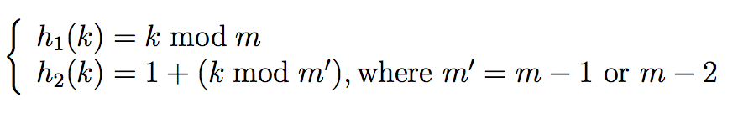
Double Hashing
There are two ways to make h₂(k) relatively prime to m :
Let m = 2^{p}, where p is some positive integer. Design h₂ so that it always produce an odd number.
Let m be a prime number. Design h₂ so that it always produces a positive integer less than m.
Example:

Slide 76
Double Hashing
In the above two cases (m is prime or m is a power of 2), θ(m²) probe sequences are used.
Every pair (h₁(k),h₂(k)) yields a distinct probe sequence.
Improvement over linear or quadratic probing as they use θ(m) probe sequences.

Slide 77
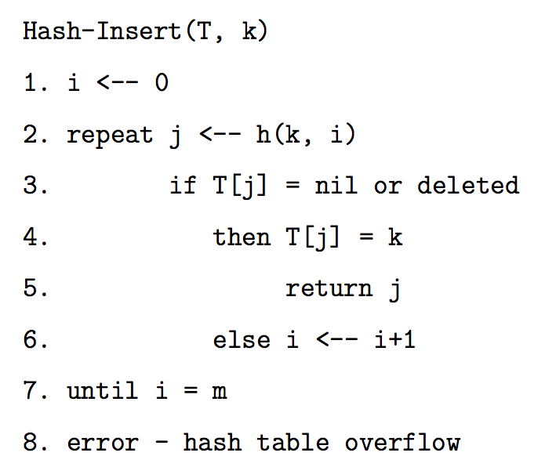
Open Addressing : Insertion
Implementing INSERTION with open addressing:

Slide 78
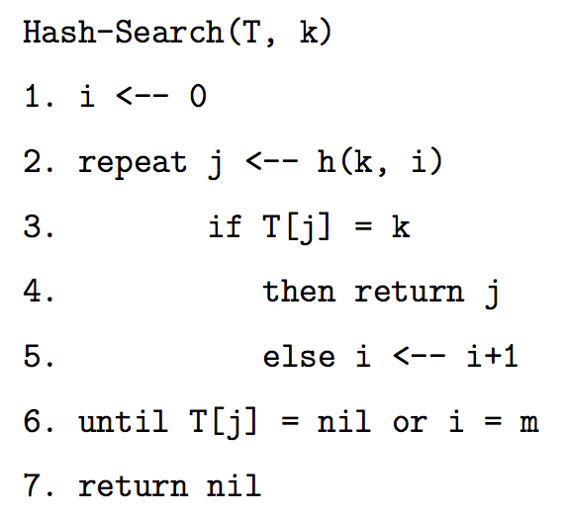
Open Addressing: SEARCH
Implementing SEARCH with open addressing:

Slide 79
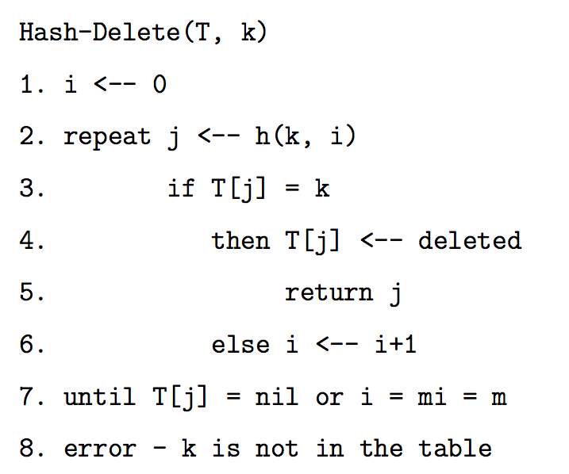
Open Addressing: DELETION
Implementing DELETION with open addressing:

Slide 80
Analysis of Open Addressing
Assuming uniform hashing, each table slot contains at most one element, so α ≤ 1 (recall α = n/m).
α is the probability of finding a slot occupied.
The expected number of probes in an unsuccessful search is at most 1/(1-α).
The expected number of probes in a successful search is at most (1/α)*ln(1/(1-α)).
If α is constant, the SEARCH operation runs in O(1).

Slide 81
Hash Tables in Java
hashCode method in Object
hashCode and equals
"If two objects are equal according to the equals (Object) method, then calling the hashCode method on each of the two objects must produce the same integer result. "
If you override equals you need to override hashCode.
Overriding one of equals and hashCode, but not the other, can cause logic errors that are difficult to track down.

Slide 82
Hash Tables in Java
HashTable class
HashSet class
Implements Set interface with internal storage container that is a HashTable.
Compared to TreeSet class, internal storage container is a Red-Black Tree.
HashMap class
Implements the Map interface, internal storage container for keys is a HashTable.

Slide 84
More on Hash Functions
Transforming the key (which may not be an integer) into an integer value
The transformation can use one of four techniques
Mapping
Folding
Shifting
Casting

Slide 85
Hashing Techniques
Mapping
As seen in the example
integer values or things that can be easily converted to integer values in key
Folding
partition key into several parts and the integer values for the various parts are combined
the parts may be hashed first
combine using addition, multiplication, shifting, logical exclusive OR

Slide 86
Shifting
More complicated with shifting
int hashVal = 0; int i = str.length() - 1; while(i > 0) { hashVal = (hashVal << 1) + (int) str.charAt(i); i--; }
different answers for "dog" and "god"
Shifting may give a better range of hash values when compared to just folding
Casts
Very simple
essentially casting as part of fold and shift when working with chars.

Slide 87
Mapping Results
Transform hashed key value into a legal index in the hash table
Hash table is normally uses an array as its underlying storage container
Normally get location on table by taking result of hash function, dividing by size of table, and taking remainder
index = key mod n
n is size of hash table
empirical evidence shows a prime number is best
1000 element hash table, make 997 or 1009 elements

Slide 88
Mapping Results
"Isabelle"
230492619
hashCode method
230492619 % 997 = 177
0 1 2 3 .........177............ 996
"Isabelle"

Slide 89
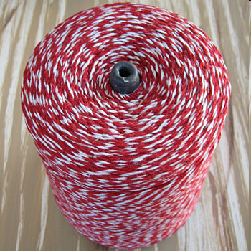
The Java String class hashCode method
public int hashCode() {
int h = hash;
if (h == 0) {
int off = offset;
char[] val = value;
int len = count;
for (int i = 0; i < len; i++)
h = 31 * h + val[off++];
hash = h;
}
return h;
}

Slide 90
Another Hash Function
Assume the hash function for String adds up the Unicode value for each character.
public int hashcode(String s) {
int result = 0;
for(int i = 0; i < s.length(); i++)
result += s.charAt(i);
return result;
}
Hashcode for "DAB" and "BAD"?
301 103
4 4
412 214
5 5
199 199

Slide 91
Another Hash Function
Assume the hash function for String adds up the Unicode value for each character.
public int hashcode(String s) {
int result = 0;
for(int i = 0; i < s.length(); i++)
result += s.charAt(i);
return result;
}
Hashcode for "DAB" and "BAD"?
301 103
4 4
412 214
5 5
199 199

Slide 92
Example: Division Method
We have n=2000 keys and we want a load factor α=3. The collisions are resolved by chaining. What is a good value for m?
Solution: m=701
Because 701 is a prime, 2000/701 ≈ 3, and 701 is not close to any power of 2.

Slide 93
How to find twin primes in a range
How to find a prime in a range [a,b]
Check all odd numbers p in the interval [a,b] for primality, and stop when you find a p that is prime.
Check if p+2 is a prime.
If yes, return the pair of numbers p and p+2.

Slide 94
Heuristic for Primality Test
Let p be the number we have to check
Perform n times the following test:
Choose a random number r in [0,p]
Check if r^{p-1} mod p = 1
If yes, p is most likely to be a prime
p is a false positive with probability 1/(10¹³)
By performing the test n=3 times, we have that p is a prime with probability 1-1/(10¹³)³, and we can accept p as a prime.
How to efficiently compute r^{p-1} mod p = 1 (next slide)

Slide 95
Modulo Exponentiation Algorithm
a^{b} mod c
Convert the exponent b in is binary value
Start with the rightmost 1 in the exponent, and write down your number (i.e. a).
For every 1, there after, square what you have, and multiply by your original number.
Compute result mod c
For every 0, after the first 1, just square what you have.
Compute result mod c

Slide 96
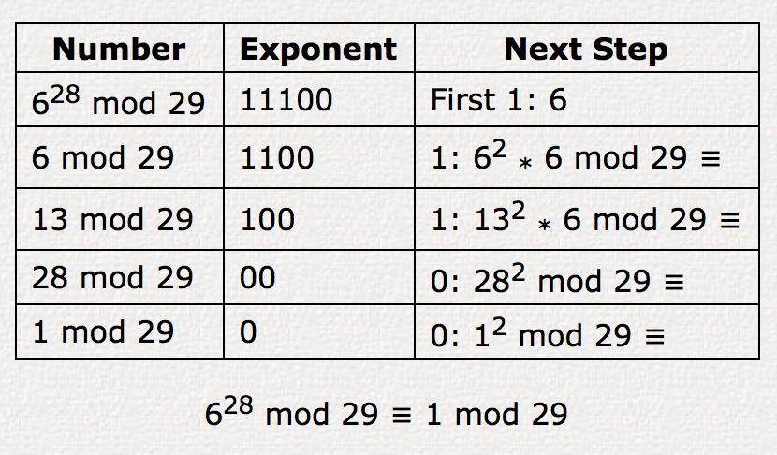
Modulo Exponentiation Algorithm
6²⁸ mod 29

